Slide 1
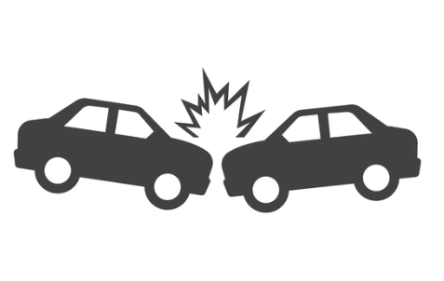
A study on the Causes of Road Accidents in UK
Sharanjit Singh, Sami Bsata & Patrick Yau

Slide 2




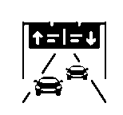

A study on the Causes of Road Accidents in UK
Weather Condition
Road Condition
Lighting Condition
Rural or Urban
Road Type
Accident Severity
Six factors were studied to determined the major cause of road accidents in UK.

Slide 3
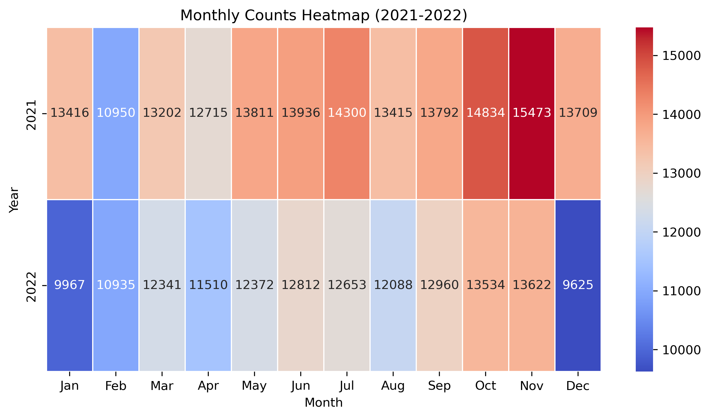
A study on the Causes of Road Accidents in UK
Year 2021: Overall, we see accidents mostly happen during month of November and lowest in February. Year 2022: Overall, we see accidents mostly happen during month of November and lowest in December.
Notes:
Accident tend to occur most during the month of October and November each year, as seen on the heatmap.

Slide 4
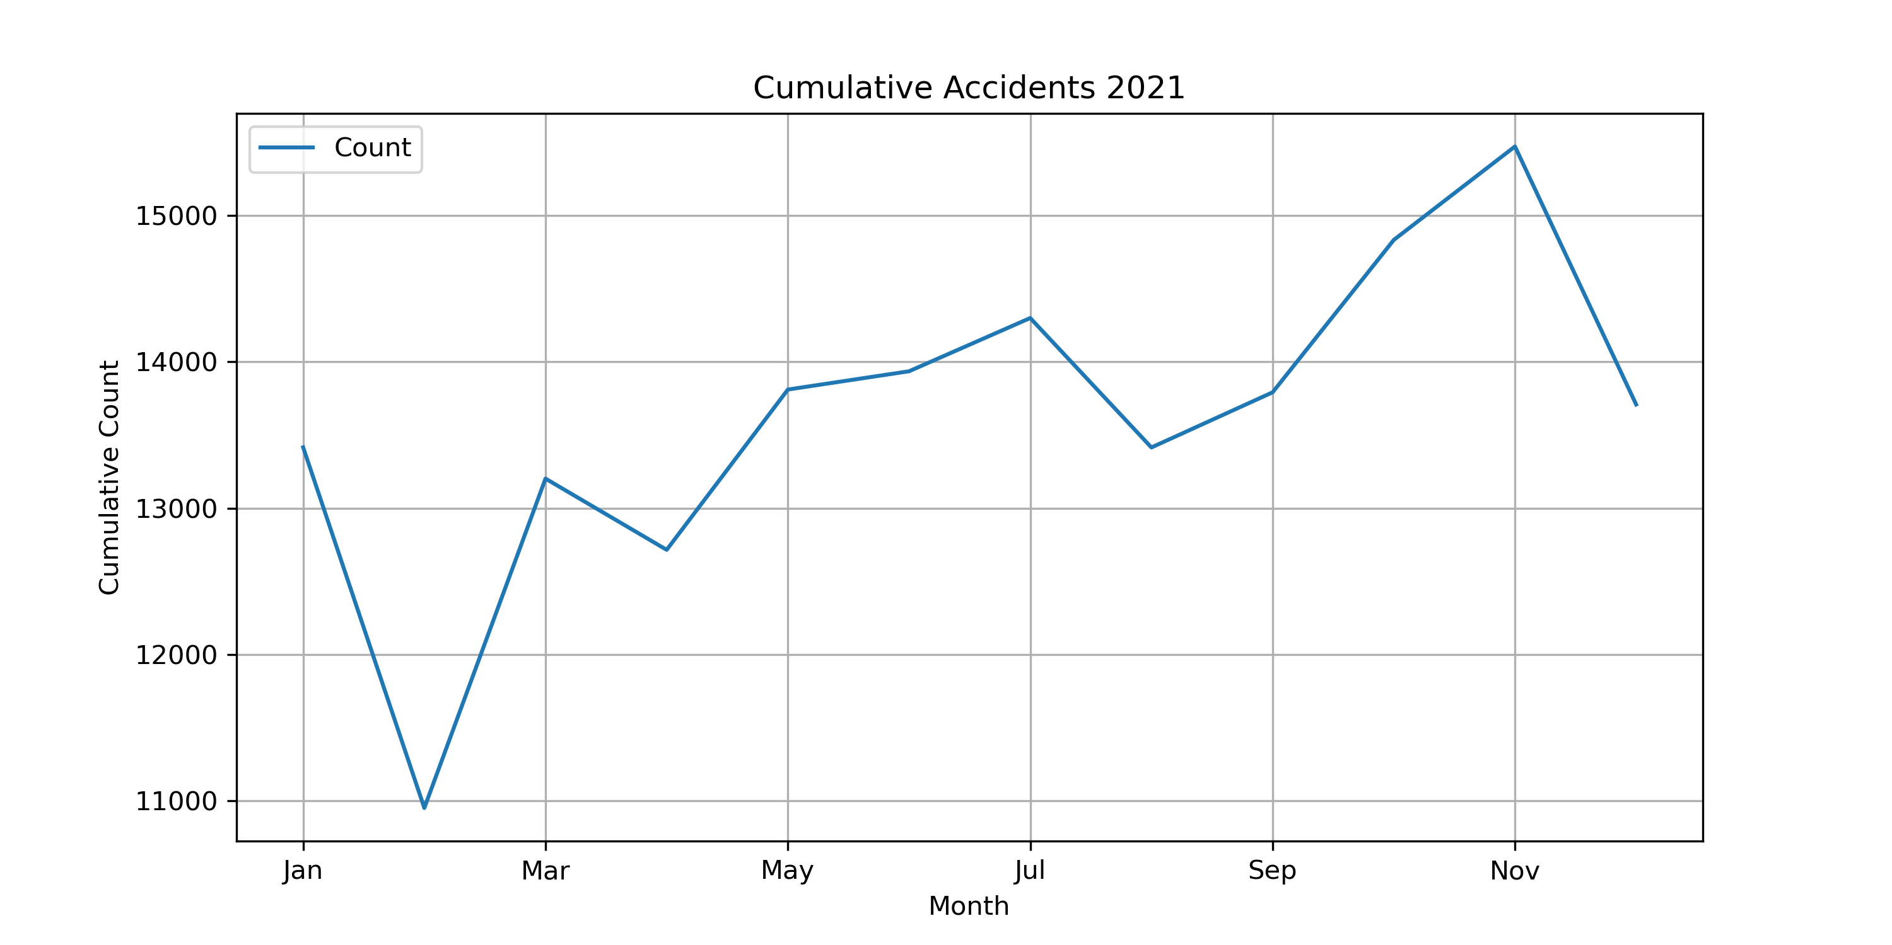
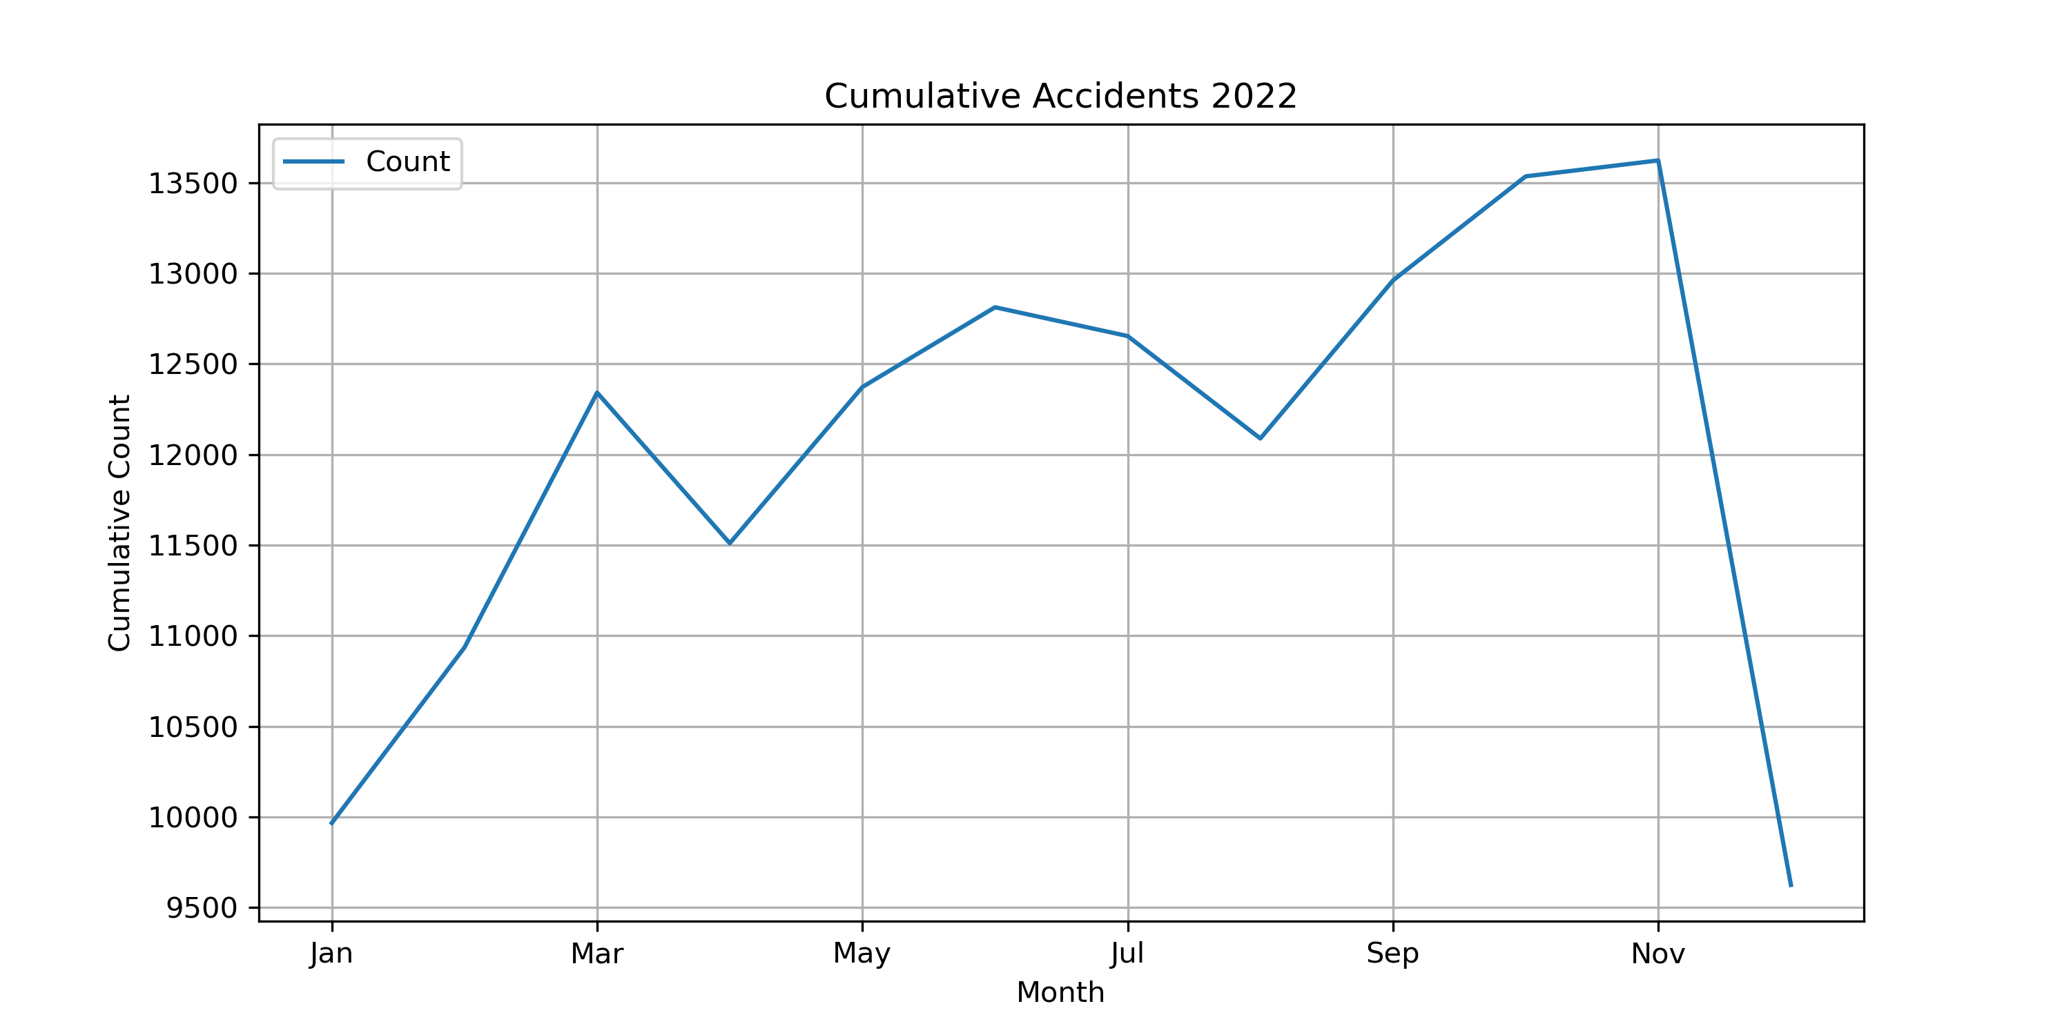
A study on the Causes of Road Accidents.
Upward trend in number of accidents throughout the year, then drops back down in December.
Notes:
As per our line graph, there is an upward trend from February to November, then in December, accidents tend to decrease.

Slide 5
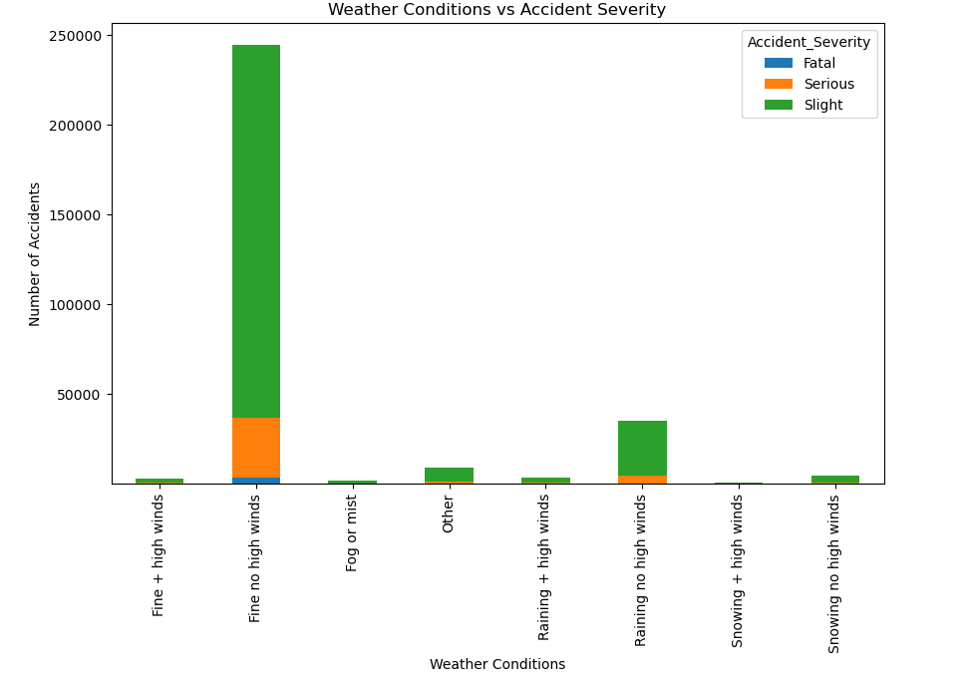
A study on the Causes of Road Accidents.
Most accident happens in perfectly fine weather condition.
Notes:
When comparing weather condition to the severity of the accidents, to our surprise, we found that most accidents occur in almost perfect weather, good weather with no high winds.

Slide 6
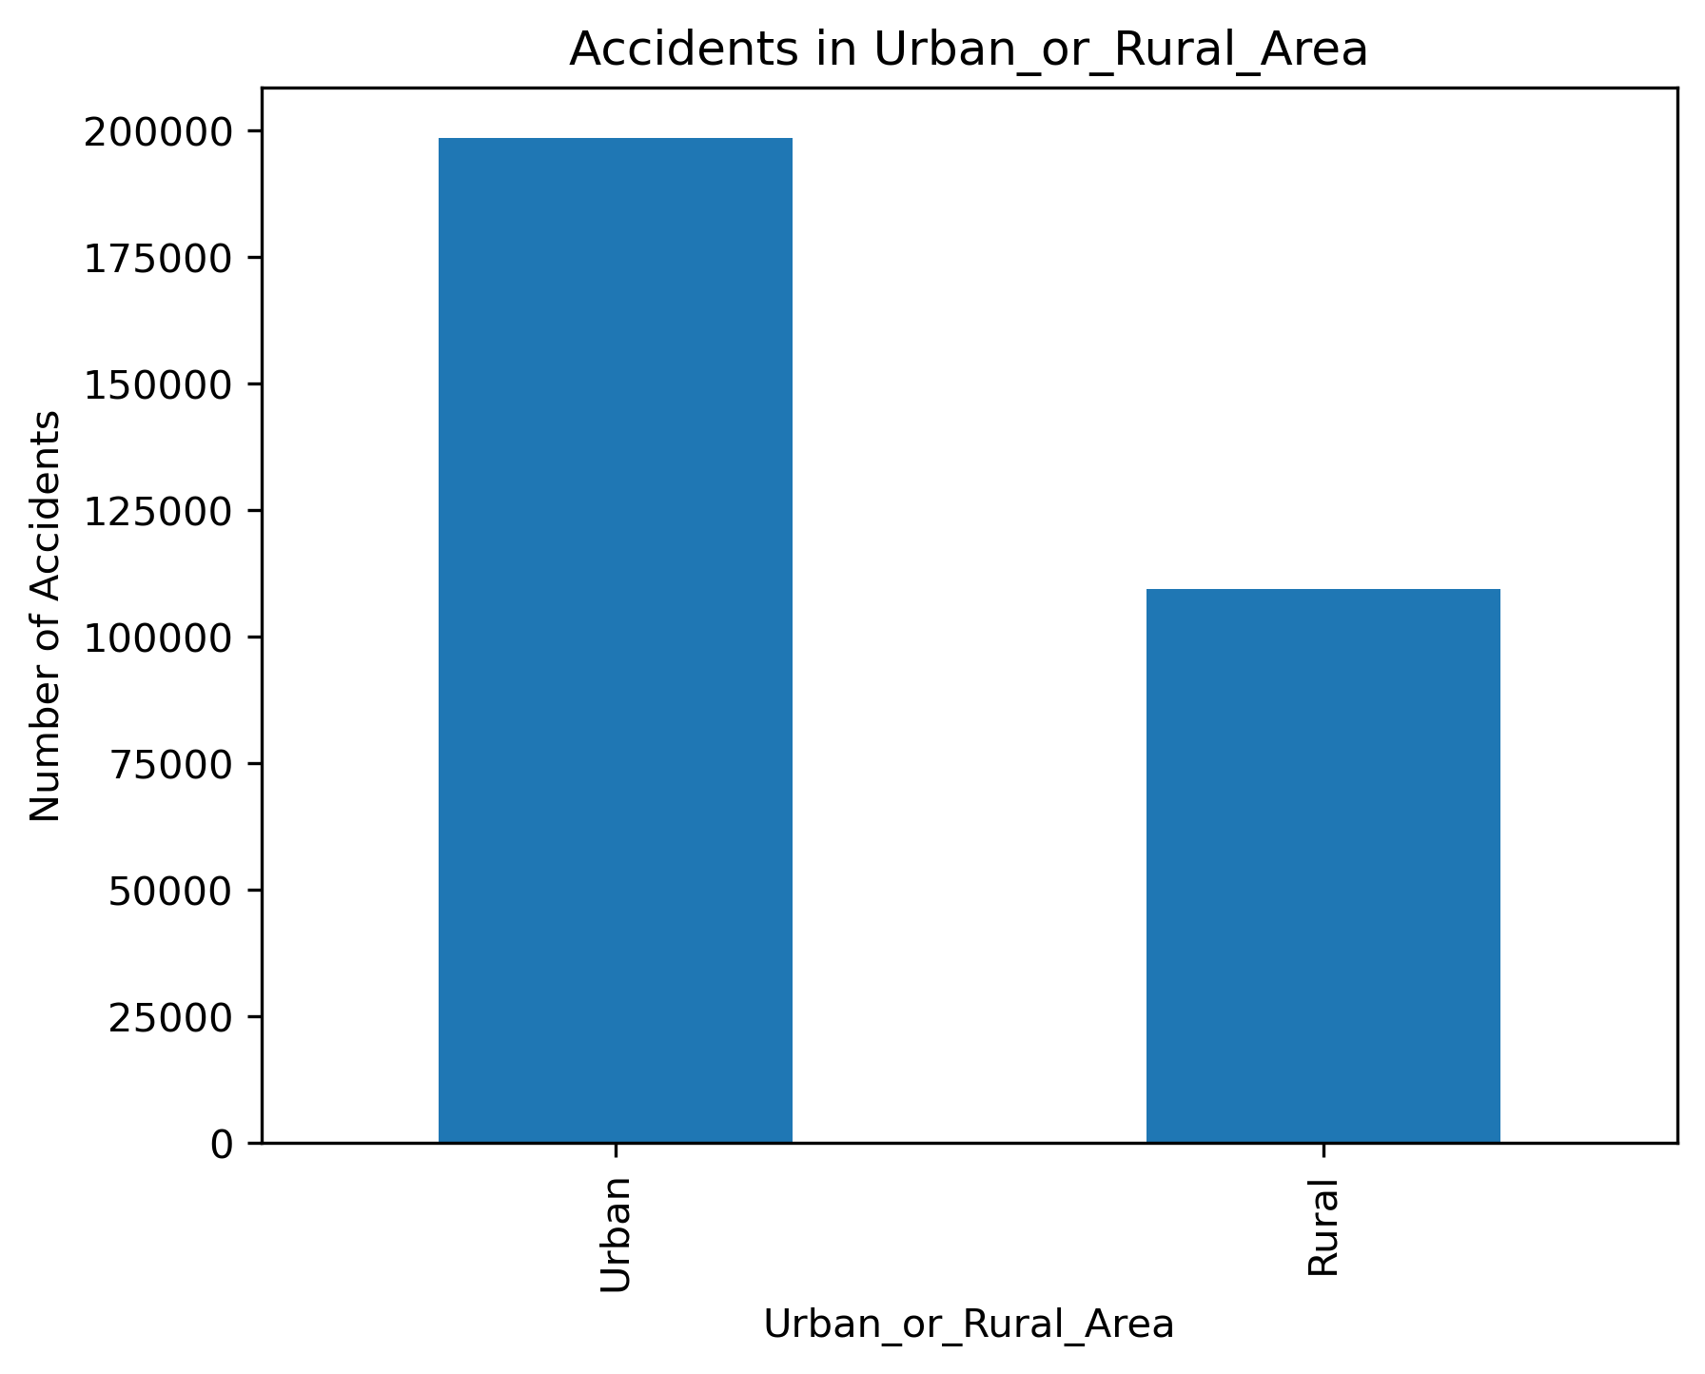
A study on the Causes of Road Accidents.
Accidents occur almost twice as much in Urban area than in Rural area.
Notes:
Accidents occur more in urban areas compared to rural areas due to their congested nature.

Slide 7
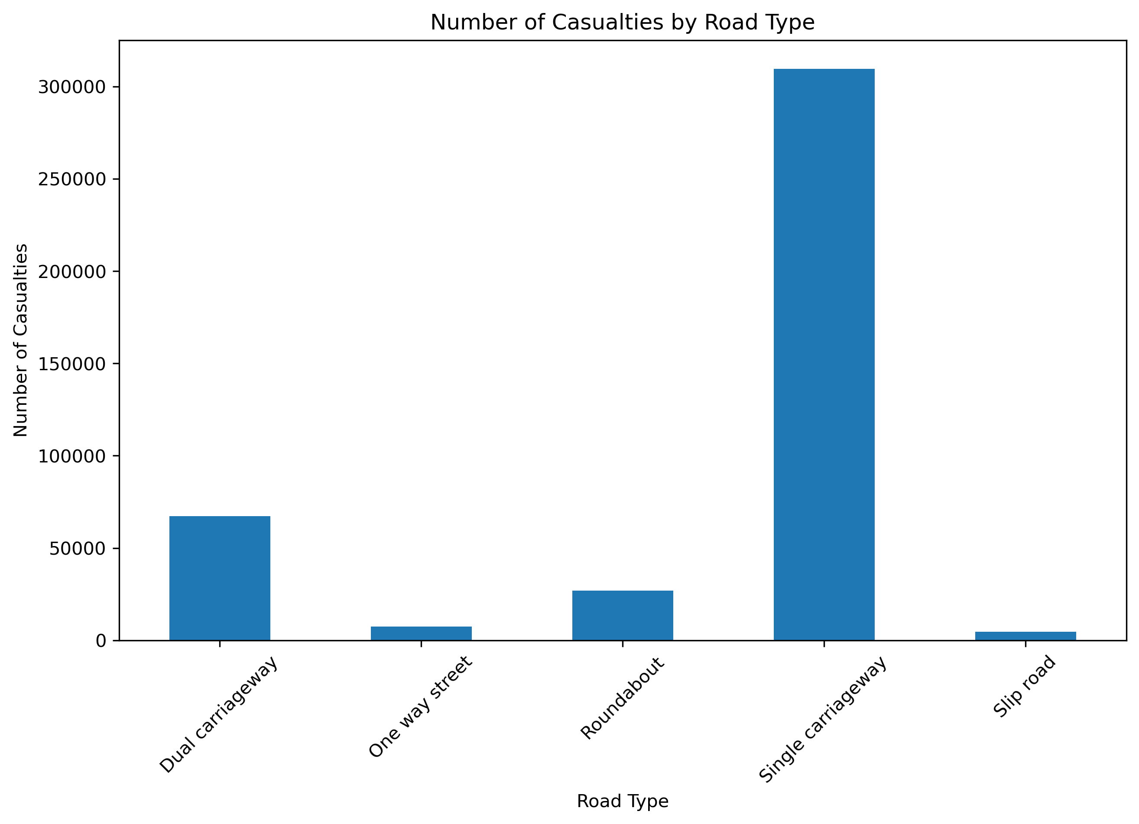
A study on the Causes of Road Accidents.
Accident occurs most when traffic traveling in opposite direction are close to each other.
Notes:
Single-carriageway roads, where there is no median between traffic traveling in opposite direction, have more casualties than other types of road types.

Slide 8
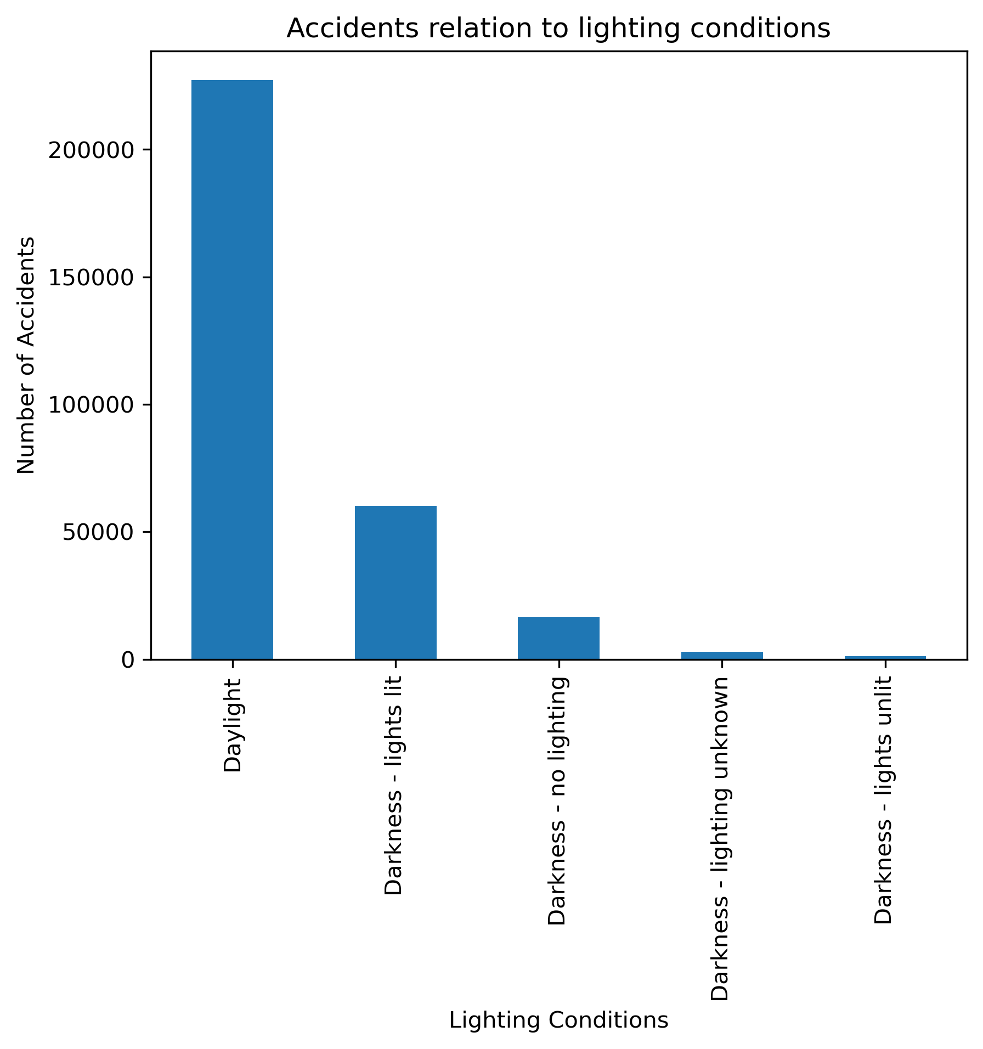
A study on the Causes of Road Accidents.
Day, Night or Level of Artificial lighting, where most accident actually happens in Daylight.
Notes:
Most accidents occur during daylight, as opposed to nighttime and on unlit roads.

Slide 9
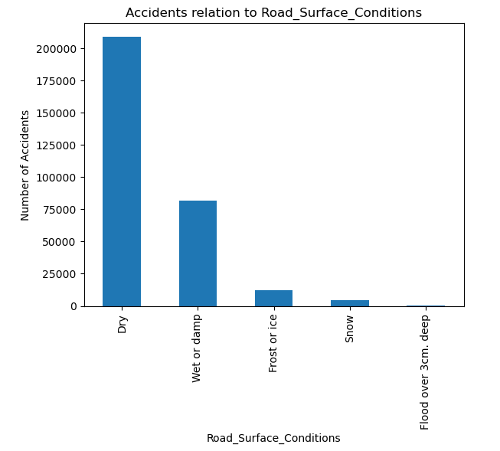
A study on the Causes of Road Accidents.
Most accidents happens on Dry road surface.
Notes:
Most accidents happen on dry road, as opposed to the icy or snowy road surface we were expecting.

Slide 10
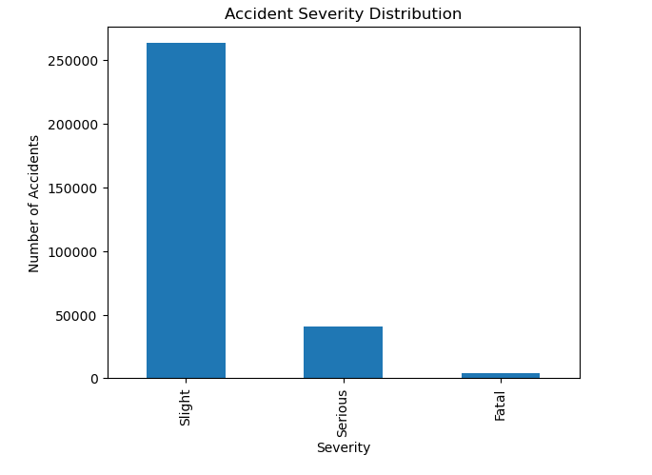
A study on the Causes of Road Accidents.
Level of severity of the accidents, minor (slight) is 5x more then Serious and Fatal combined
Notes:
Minor accidents (slight severity accidents) happen the most, compare to serious and fatal accidents.

Slide 11
Conclusion:
Most accidents happen in good weather, with good lighting and good road conditions, and on single-carriageway road where there is no median to protect traffic traveling in opposite direction.
Accidents happen most in urban areas where drivers have more to look out for, such as traffic signs and signals, surrounding vehicles, pedestrians and cyclists.
These findings lead us to think that there can be other possible factors like driver distraction may be possible cause of accidents which is not present in the given data and needs to be reviewed and limitation of our studied data set.

Slide 12
References
https://natural-resources.canada.ca/energy-efficiency/transportation-energy-efficiency/personal-vehicles/autosmart-driver-training
https://www.kaggle.com/datasets/xavierberge/road-accident-dataset
https://chatgpt.com

